Slide 1
Using your calculator efficiently
Arithmetic procedures with integers and decimals

Slide 2
how to use Oak lessons

Slide 3
I can fluently use certain calculator functions and use a calculator appropriately.

Slide 4

Evaluate means to find the value of a numerical or an algebraic expression.
Example
Example
Evaluate
Evaluate
100 ÷ 2 + 5
= 55
8 + 8
= 16

Slide 5

Using your calculator efficiently
Negatives and operations
Brackets and operations

Slide 6
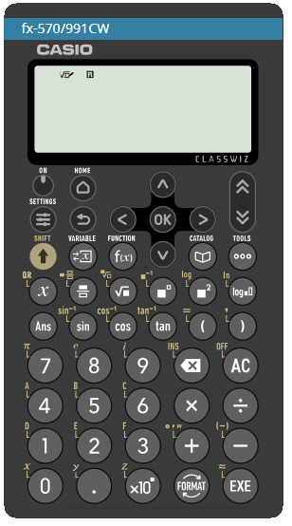
Negatives and operations
There are lots of different scientific calculators, but all have very similar functionality and notation.

Slide 7
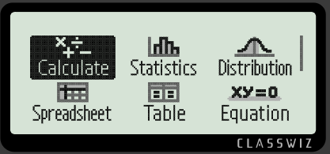
Negatives and operations
When turning on your calculator, there will be different applications available.
Ensure the “Calculate” is selected and press “OK” or “EXE”.
To return back to all the applications press the “HOME” key.

Slide 8
Negatives and operations
We are going to go through the main operations with the fx-570/991CW.
Can you find the four main operations:
+, −, × and ÷ ?

Slide 9
Negatives and operations
Can you find the “negative” button?

Slide 10

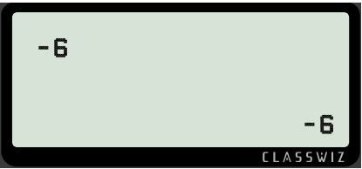
Negatives and operations
There are two ways to access the “negative”.
Press SHIFT and then the “minus”.
This will show the proper negative sign.
Example

Slide 11
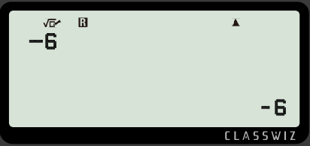
Negatives and operations
There are two ways to access the “negative”.
Or use the “minus” key.
The calculator will know and adjust the number to a negative.
Example

Slide 12

Negatives and operations
Can you find the button that will execute the calculation?
There are two buttons that will do this.

Slide 13

Negatives and operations
Can you find the
“square” button?

Slide 14
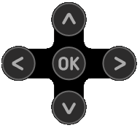
Negatives and operations
These are very important keys and allow you to move around the calculator screen and your calculation.
Can you find the
“cursor” buttons?

Slide 15

Negatives and operations
This is a powerful key as it allows you to change the format of your answer.
Can you find the
“FORMAT” button?

Slide 16








Negatives and operations
There are many more, but these are the main buttons we will use in this lesson.
Execute
Cursor keys
Change format
Multiply
Divide
Square
Fraction
Addition
Square root
Power
Subtraction or negative
Brackets

Slide 17
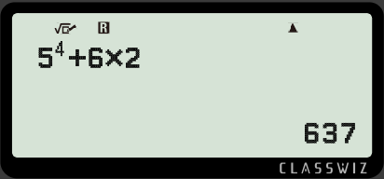

Negatives and operations
The cursor keys will allow you to move around the functions, applications and calculations on your calculator screen. It is an important key to leave or enter an operation.
What buttons need to be pressed to get this calculation on the screen?

Slide 18
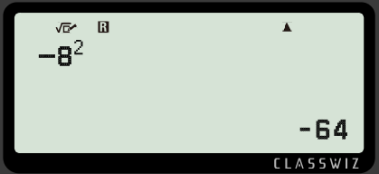
Negatives and operations
Alex is asked by the teacher to square negative 8.
He thinks he inputs it in correctly to give an answer of -64.
What should have Alex inputted into the calculator?
b) How did the calculator get an answer of -64?

Slide 19
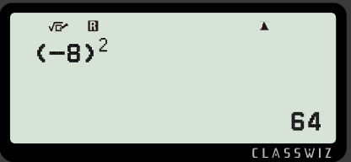
Negatives and operations
Alex is asked by the teacher to square negative 8.
He thinks he inputs it in correctly to give an answer of -64.
What should have Alex inputted into the calculator?
Negatives should be inputted within brackets.

Slide 20
Negatives and operations
Alex is asked by the teacher to square negative 8.
He thinks he inputs it in correctly to give an answer of -64.
b) How did the calculator get an answer of -64?
Scientific calculators have the priority of operations installed into their programming. The calculator is performing the exponent first then multiplication.
8² and then multiplying it by negative 1. Thus giving -64

Slide 21






Negatives and operations
Three students were given the same question.
My answer is 21
My answer is 23
I got Math ERROR
Andeep
Izzy
Aisha
Who is correct?
What buttons need to be pressed to work out the correct answer?

Slide 22

Negatives and operations
Three students were given the same question.
My answer is 21
My answer is 23
I got Math ERROR
Andeep
Izzy
Aisha
Aisha
Who is correct?
What buttons need to be pressed to work out the correct answer?

Slide 23
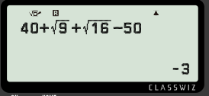
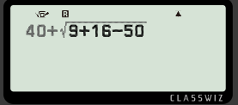
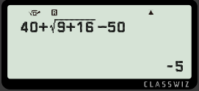

Negatives and operations
Match the correct calculation on the calculator with the correct answer.
My answer is -5
My answer is -3
I got Math ERROR
Andeep
Aisha
Izzy

Slide 24

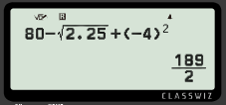
Negatives and operations
Your calculator may give you an answer in a different format you want.
Example
Work out
Give your answer as a decimal.

Slide 25
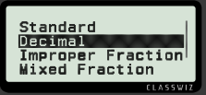
Negatives and operations
Your calculator may give you an answer in a different format you want.
Example
Work out
Give your answer as a decimal.

Slide 26
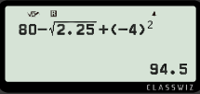
Negatives and operations
Your calculator may give you an answer in a different format you want.
Example
Work out
Give your answer as a decimal.

Slide 27
Negatives and operations
Once an answer is obtained from a calculation, you can select it in any format available.

Slide 28


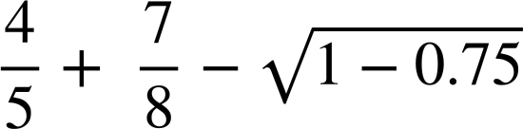
Negatives and operations
1) Work out the following with your scientific calculator. Give your answer in decimal form.
c)

Slide 29
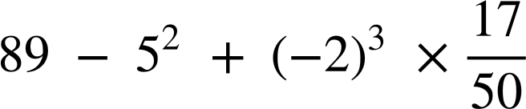

Negatives and operations
2) Work out the following with your scientific calculator. Give your answer in fractional form.
a)
b)
c)

Slide 30
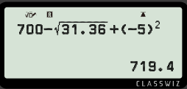
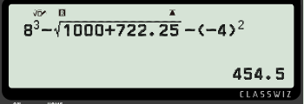
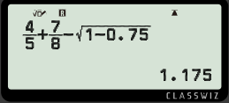
Negatives and operations
1) Work out the following with your scientific calculator. Give your answer in decimal form.
c)

Slide 31
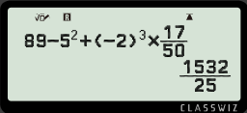
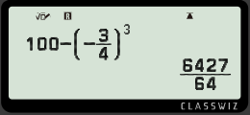
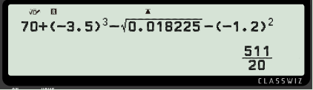
Negatives and operations
2) Work out the following with your scientific calculator. Give your answer in fractional form.
a)
b)
c)

Slide 32
Using your calculator efficiently
Negatives and operations
Brackets and operations

Slide 33
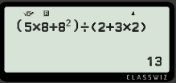

Brackets and operations
Sometimes we use brackets to see the grouping of the numbers together.
This can be used with the fraction button to show a division.
Example
Work out the answer to this calculation with your calculator.

Slide 34
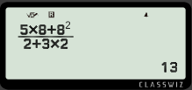
Brackets and operations
Press the fraction button and insert the calculation for
the top of the fraction. Scroll to input the bottom of the calculation.

Slide 35
Brackets and operations
Division can be inputted using or

Slide 36
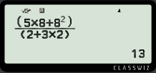
Brackets and operations
Do you think the answers would be different if we use brackets?
The expressions on the numerator and denominator do not need to be expressed with the brackets because of the extended division line.

Slide 37


Brackets and operations
What about these calculations?
The grouping does not need to be expressed with the brackets because they are all grouped by the exponent function.

Slide 38

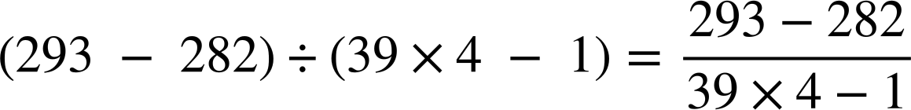

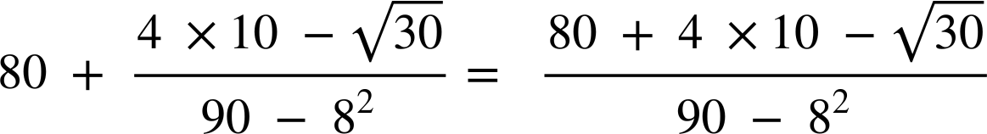
Brackets and operations
Identify if these calculations are equal without using a calculator.
=
=
We need brackets here as we have a negative number
≠
≠

Slide 39
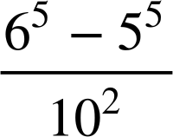
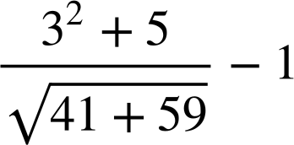
Brackets and operations
1) Work out the following with your scientific calculator. Give your answer in decimal form.
c)

Slide 40
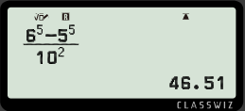
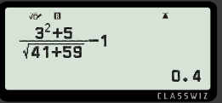
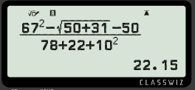
Brackets and operations
1) Work out the following with your scientific calculator. Give your answer in decimal form.
c)

Slide 41
Using your calculator efficiently
The cursor keys will navigate you around the different functions, applications and calculations on the calculator screen.
Division can be inputted via the fraction button.
Brackets help isolate negative numbers and improve accuracy.
Sometimes brackets are optional if an operation groups the calculation.

Slide 42

© Oak National Academy 2023.
Produced in partnership with Mathematics in Education and Industry.
Licensed on the Open Government Licence v3.0, except where otherwise stated. See Oak terms and conditions.

